Slide 2
Program Testing (Continued)
Slides taken from Prof. R. Mall
Dept. of CSE, IIT, Kharagpur

Slide 3
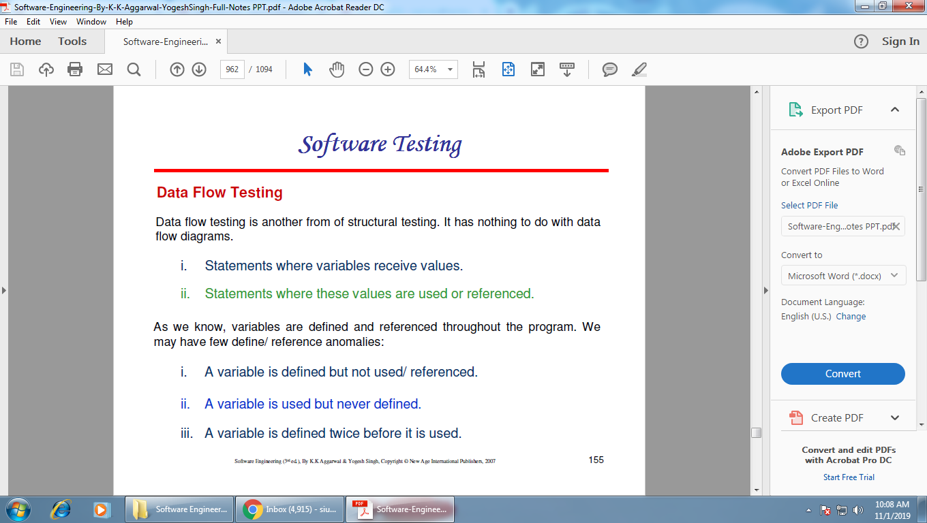

Slide 4
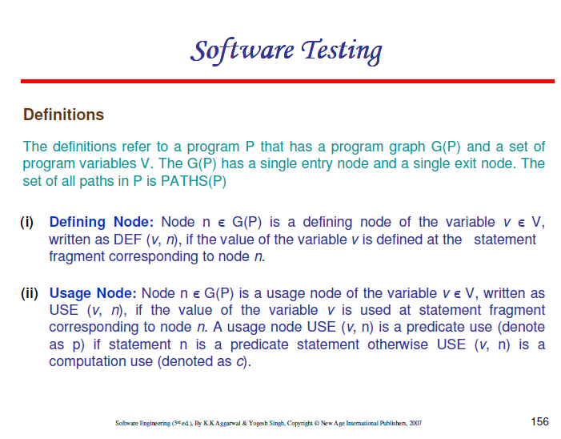

Slide 5
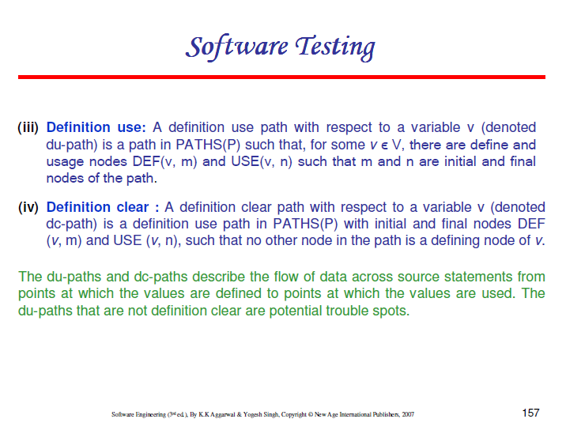

Slide 6
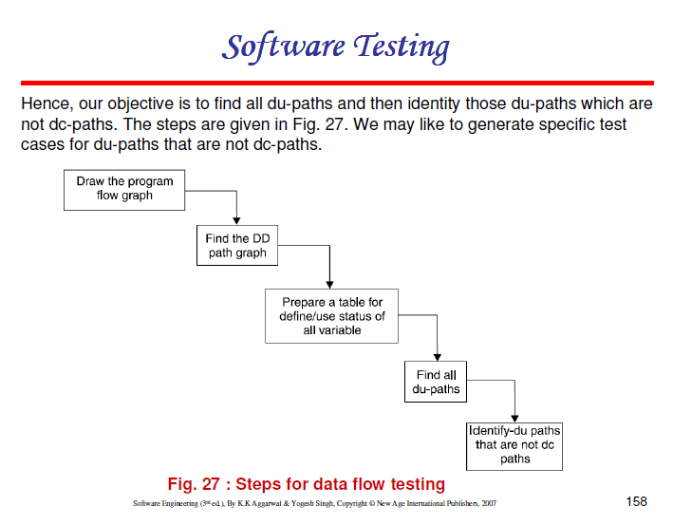
CFG

Slide 7
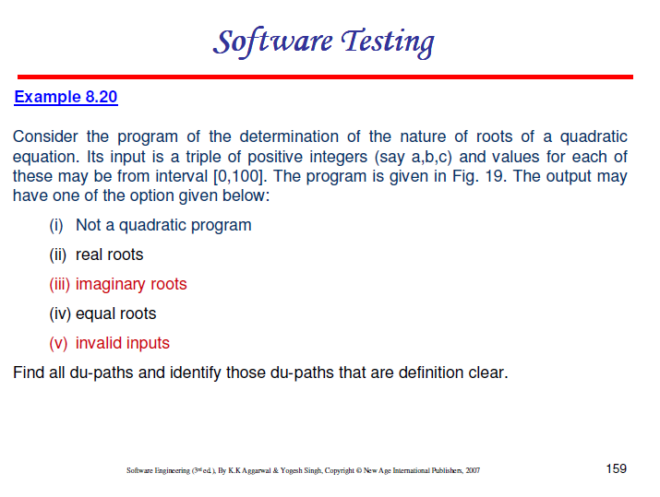

Slide 8
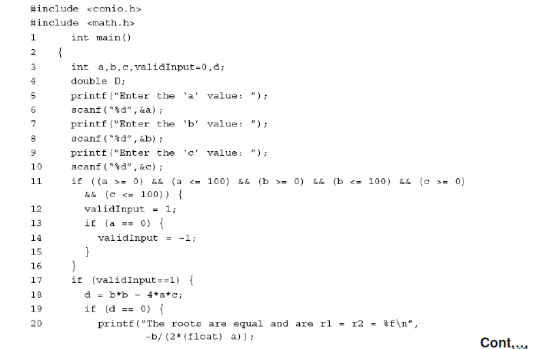
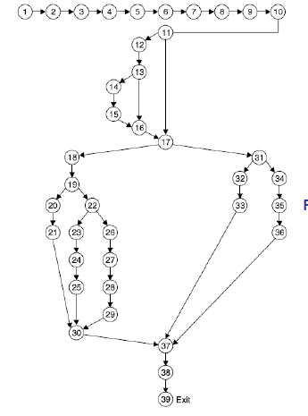
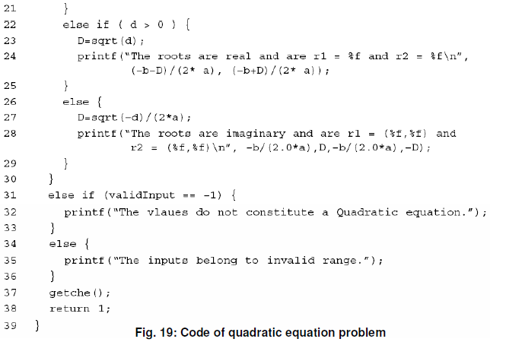
-b/2*a

Slide 9
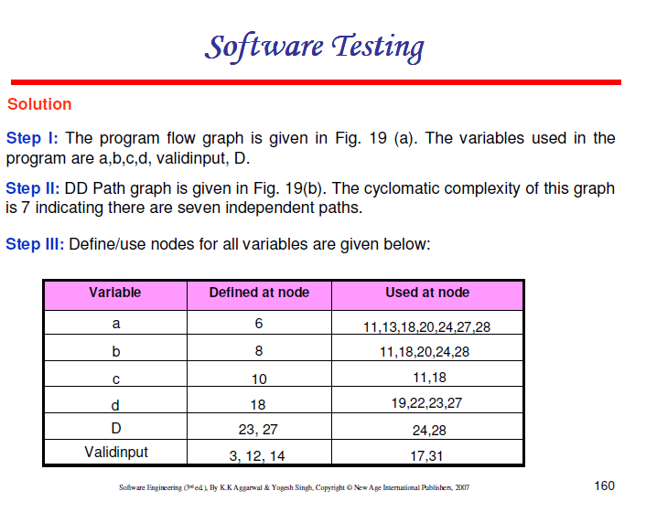

Slide 10
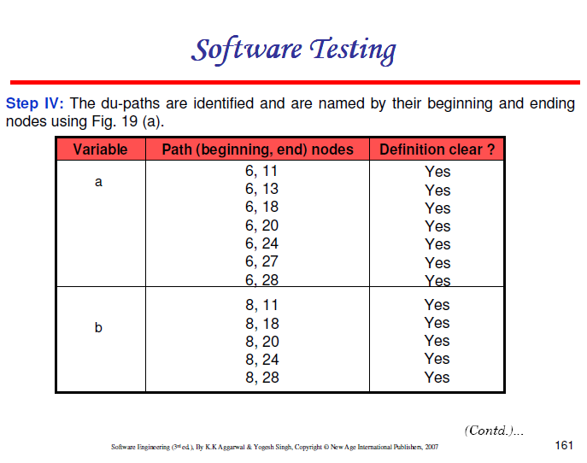

Slide 11
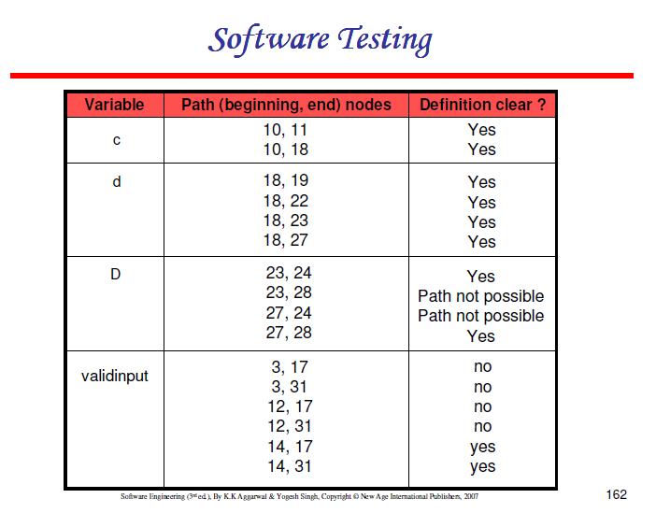
Our emphasis should be to generate test cases for all 26 du-paths and if not possible, then at least for 4 du-paths that are not definition clear

Slide 12

Error Seeding

Slide 13
